Slide 1
Part I: 15 sec GHA
Updated 07/13/2019
Bootstrap: 1000
$$coxph\left(time, event\right)=GHA+Male+GHA ×Male$$
$$h_{0−8}(x)=h_{o}exp⁡[4.18I_{GHA}−0.70I_{Male}−{0.08I}_{GHA}×I_{Male}]$$
$$h_{8−12}(x)=h_{o}exp⁡[4.18I_{GHA}−1.59I_{Male}+{1.94I}_{GHA}×I_{Male}]$$
$$h_{12−19}(x)=h_{o}exp⁡[4.18I_{GHA}+0.43I_{Male}−0.22I_{GHA}×I_{Male}]$$
Cut off at Day 19
Notes:
Updated 07/13/2019

Slide 2
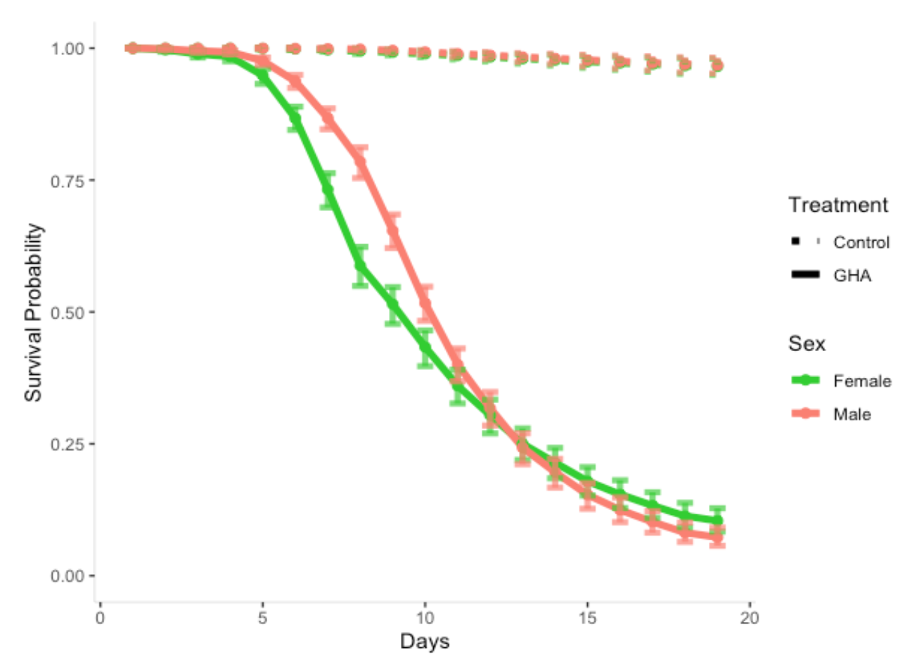
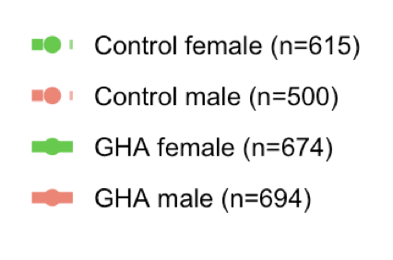
Updated 07/13/2019
Survival Probability of Control and GHA
Bootstrap: 1000
Cut off at Day 19
Notes:
Updated 07/13/2019

Slide 3
Updated 07/13/2019
*Baseline: control/fungal male
Treatment | Hazard ratios between sex | 0 - 8 | 8-12 | 12 – 19
Control | Male vs Female (p-value) | 2.02 (0.3777) | 4.90 (0.1663) | 0.65 (0.2710)
Fungal | Male vs Female (p-value) | 2.20 (0.0001) | 0.69 (0.0045) | 0.81 (0.1067)
Notes:
Updated 07/13/2019

